Slide 1

Effect of Dexmedetomidine on Mortality and Ventilator-Free Days in Patients Requiring Mechanical Ventilation With Sepsis
Olivia Zhang (V00885977), Harshit Handa (V00919882), Rory Davies (V00875731)

Slide 2
Hypothesis
The primary endpoint is to evaluate whether the use of dexmedetomidine would improve the mortality and ventilator-free days in the 28 days following being put on ventilators among patients in Intensive Care Unit (ICU) with sepsis.
The secondary endpoint is to measure whether sedatives including dexmedetomidine would improve the quality of life for the septic patients in ICU who are on ventilators.

Slide 3
Scientific Importance
To concur the causal relationship between the use of dexmedetomidine in sedatives and the suppression of inflammatory system responses, namely, patients with sepsis, with studies that have been conducted on the subject.
To establish the said causal relationship applies to septic patients who are on ventilators, and it would improve patient outcomes.

Slide 4
Findings
There is no significant difference in 28 days mortality between the case group and the control group (19 vs. 28 patients; 22.8% vs. 30.8%).
There is no significant difference in the number of ventilator-free days over 28 days between the case group and the control group (median: 20 vs. 18 days).
The case group, who have been put on dexmedetomidine, has statistical significant fewer incidents of delirium or agitation during mechanical ventilation than the control group.
Adverse events, arrhythmia or myocardial ischemia, occurred in eight (8%) and three (3%) patients in case group and control group, respectively.

Slide 5
Data Collection
The study was conducted in 8 ICU wards in Japan from February 2013 to January 2016.
203 patients enrolled to the trial; 201 patients were randomized into dexmedetomidine group (n=100) and control group (n=101). 99 patients in dexmedetomidine group and 95 patients in control group were given the assigned interventions.
Patients are 20 years or older and are ICU patients who have sepsis , who have been put on mechanical ventilation for at least 24 hours, regardless the mechanism of the ventilation.
The study recorded the occurrence of death, ventilator-free days over 28 days, assessment score of Sequential Organ Failure Assessment (SOFA), Richmond Agitation-Sedation Scale (RASS), and Confusion Assessment Method for ICU patients (CAM-ICU), and the sites of infections. Patients’ gender and age are also collected.

Slide 6
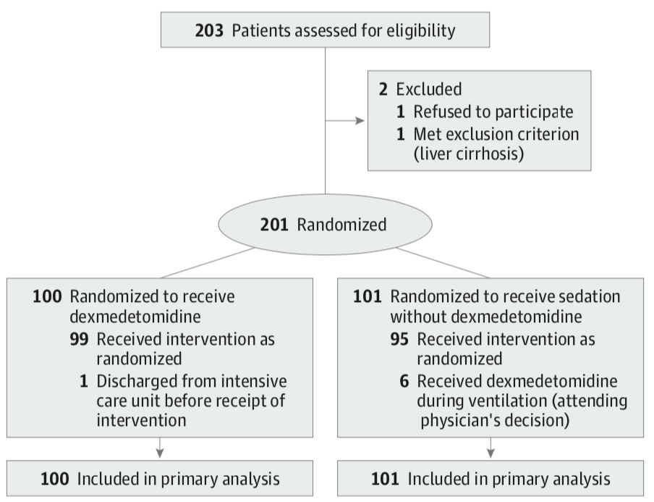
Figure 1. Flow of Participants in the Dexmedetomidine for Sepsis in Intensive Care Unit Randomized Evaluation Trial

Slide 7
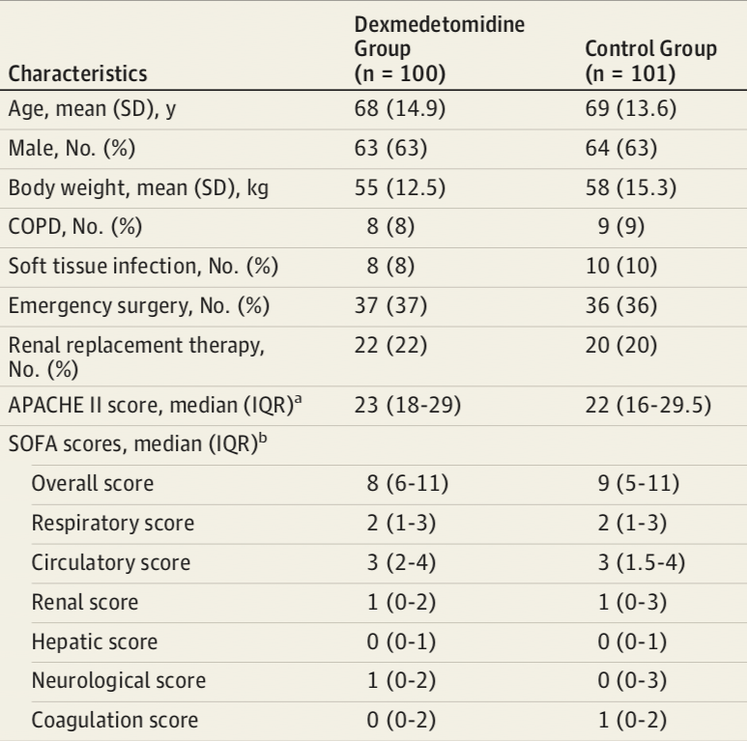

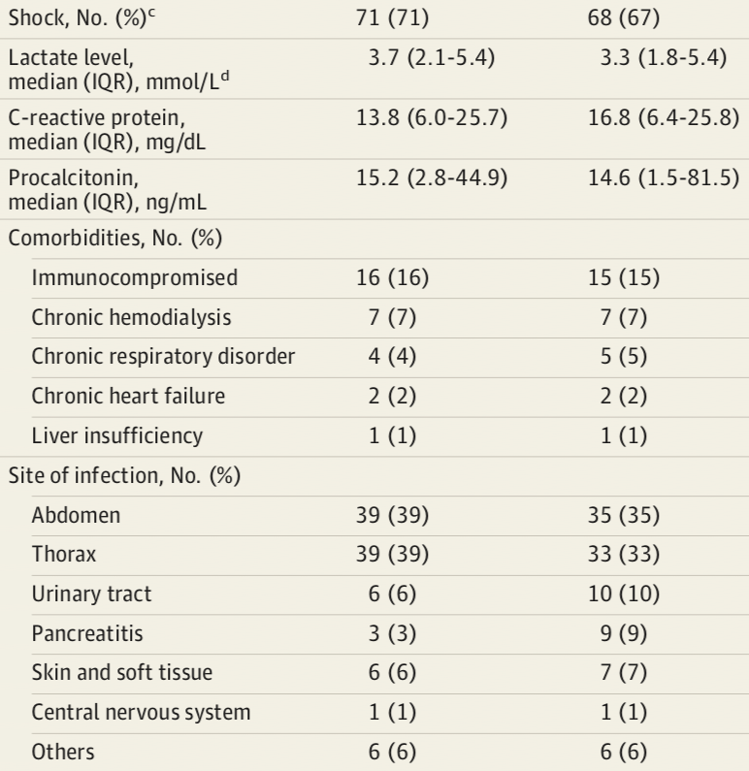
Table 1. Participant Characteristics

Slide 8
Statistical Methods
Primary Endpoints:
To compare the 28-day mortality between groups, the log-rank test and Cox proportional hazard model was used
To compare the 28-day ventilator free days between groups, the Wilcoxon rank sum test was used
Secondary Endpoints:
comparison between the two groups in variables such as length of ICU stay, cognitive function, and organ failure control, the Wilcoxon rank sum test was used
For comparison between the two groups in variables such as agitation & delirium, sedation control, and renal function, χ2 tests or Fisher exact tests were used.
a generalized linear model was used to examine the effects of dexmedetomidine on sedation control and the occurrence of delirium and coma
Notes:
For the paper, a number of statistical methods were used to evaluate both primary and secondary efficacy measures.

Slide 9
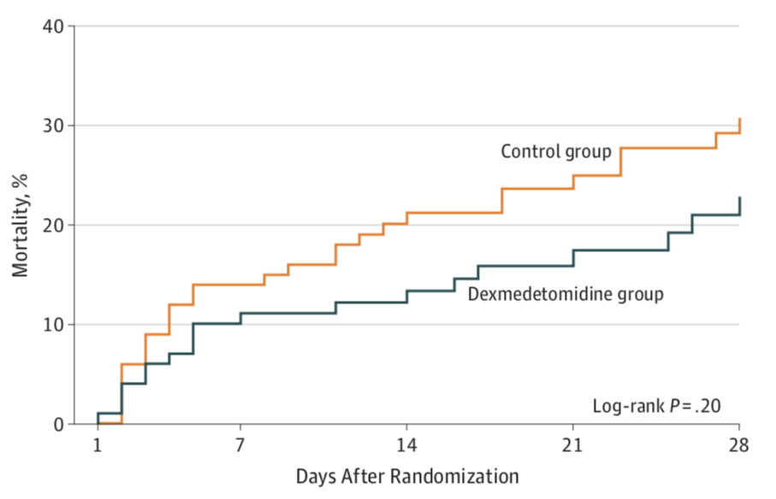
Figure 2. 28-Day Mortality Among the Dexmedetomidine and Control Group
Notes:
Figure 2 in the paper plots the kaplan meier curve for the dexmedetomidine group in green and the control group in orange. the kaplan meier curves show the estimated mortality rate of over the 28 days for both groups. As clearly seen in the graph, the control group experienced about 8% higher mortality over the 28 days compared to the case group. This 8%, though clinically significant, is not statistically significant since the log-rank test determined a high p-value of 0.2 due to the low power of the study. Both the kaplan-meier method and the log rank test are typically used together in survival analysis.

Slide 10
Reference
Kawazoe, Y., Miyamoto, K., Morimoto, T., Yamamoto, T., Fuke, A., Hashimoto, A., … Yamamura, H. (2017). Effect of dexmedetomidine on mortality and ventilator-free days in patients requiring mechanical ventilation with sepsis. JAMA, 317(13) p1321-p1328. doi:10.1001/jama.2017.2088

